Slide 1

SIDDHARTH INSTITUTE OF ENGINEERING & TECHNOLOGY (AUTONOMOUS)
DEPARTMENT OF ELECTRONICS AND COMMUNICATION ENGINEERING
SECTION NO - 2
BATCH NO - 12
STEPHEN HAWKING WHEELCHAIR MODEL CONTROLLED BY MEMS MOTION
TEAM MEMBERS:
KALAKADA KETHAVARDHAN REDDY : 18F61A0499
KUPPALA KISHORE : 18F61A04A1
KONDETI LAVAKUMAR : 18F61A04A7
GORLA JAYA PRAKASH YADAV : 18F61A0484
Under the esteemed guidance of :
K.D.MOHANA SUNDARAM M.Tech., MIETE., MISTE., (Ph.D).
Assistant Professor.

Slide 2
Abstract
This project is to develop a wheelchair control which is useful to the physically disabled person with his hand movement or his hand gesture recognition using Acceleration technology. Tremendous leaps have been made in the field of wheelchair technology.
However, even these significant advances haven’t been able to help quadriplegics navigate wheelchair unassisted. It is wheelchair which can be controlled by simple hand gestures. It employs a sensor which controls the wheelchair hand gestures made by the user and interprets the motion intended by user and moves accordingly.
In Acceleration we have Acceleration sensor. When we change the direction, the sensor registers values are changed and that values are given to microcontroller. Depending on the direction of the Acceleration, microcontroller controls the wheelchair directions like LEFT, RIGHT, FRONT, and BACK. The aim of this project is to implement wheelchair direction control with hand gesture reorganization.

Slide 3
Motivation Behind The Project
The number of persons who are paralyzed and therefore dependent on others due to loss of self mobility is growing with the population. The development of the wheelchair for paralyzed users is surprisingly recent starting with the conventional manually powered wheelchairs and advancing to electrical wheelchairs.
Conventional wheelchair use tends to focus exclusively on manual use which use which assumes users still able to use their hands which excludes those unable to do so.
Diseases or accidents injuring the nervous system also frequently because people lose their ability to move their voluntary muscle. Because voluntary muscle is the main actuator enabling people to move their body, paralysis may cause a person not move their locomotor organ such as arm, leg and others.
Scientist Stephen W. Hawking is perhaps the most well-known victim of major paralysis – Hawking was diagnosed with incurable Amyotrophic Lateral Sclerosis (ALS) in 1962, thereafter using a wheelchair to move.

Slide 4
Literature Survey
S.no | Author | Title | Problem | Summary
1. | S. Senthil Kumar | “Robotic Arm Control through Internet/LAN for Patient Operation” | Vol. 4, Issue 7, July 2015. | International Journal of Advanced Research in Electrical, Electronics and Instrumentation Engineering,
2. | Vivek Bhojak , Girish kumar Solanki, Sonu Daultani | Gesture Controlled Mobile Robotic Arm Using Accelerometer | IJIRSET Vol. 4, Issue 6, June 2015. | One accelerometer is mounted / attached on the human one hand, capturing its behaviour and thus the robotic arm moves accordingly and the other accelerometer is mounted on other hand of the user / operator, capturing its gestures and postures and thus the platform moves accordingly. The robotic arm and platform is synchronised with the gestures and postures of both hands of the user / operator, respectively.

Slide 5
Proposed System
In this proposed system we are using MEMS sensor (Accelerometer sensor) to control the motion of the robot. The commands for robot movement are given by using Accelerometer. The Robot will receive the changes from the MEMS Sensor. Then if any threshold value is crossed then the robot will move accordingly.

Slide 6
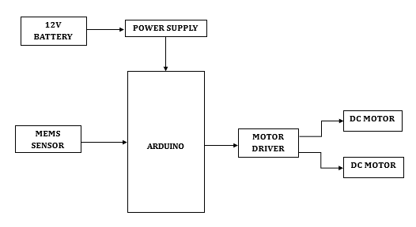
Block Diagram
The above system represents, any change in the direction of MEMS sensor in X- and Y-axis directions then this MEMS sensor has piezo resistive material at the center of the chip, which is suspended by 4 beams doped with piezo resistive material. When the sensor is subjected to acceleration in any direction, the movement of the mass causes the 4 beams to deform and so changes the resistance of the piezo material. Depending on the direction of the MEMS, microcontroller controls the wheel chair directions like LEFT, RIGHT, FRONT, and BACK By implementing the above circuit

Slide 7
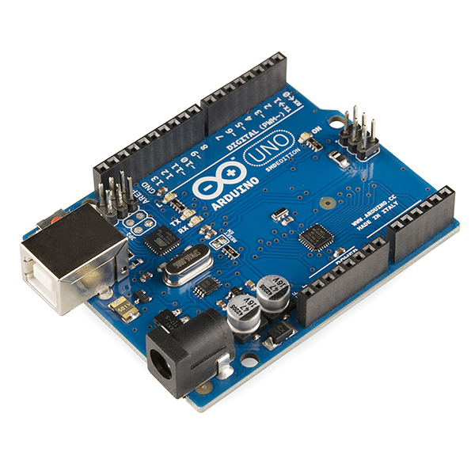
Hardware Details
1.Arduino
The Uno with Cable is a micro-controller board base on the ATmega328. It has 14 digital input/output pins (of which 6 can be used as PWM outputs); 6 analog inputs, a 16 MHz ceramic resonator, a USB connection, a power jack, an ICSP header, and a reset button.
It contains everything need to support the microcontroller; simply connect it to a computer with a USB cable or power it with an AC-to-DC adapter or battery to get started.

Slide 8
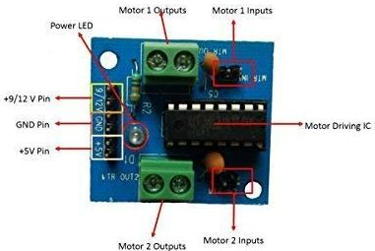
2.Motor Driver
L293D is a typical Motor driver or Motor Driver IC which allows DC motor to drive on either direction. L293D is a 16-pin IC which can control a set of two DC motors simultaneously in any direction.
It means that you can control two DC motor with a single L293D IC. Dual H-bridge Motor Driver integrated circuit (IC).

Slide 9
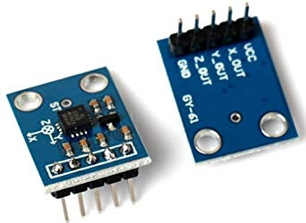
3.MEMS Sensor
MEMS are low-cost, and high accuracy inertial sensors and these are used to serve an extensive range of industrial applications. This sensor uses a chip-based technology namely micro-electro-mechanical-system.
These sensors are used to detect as well as measure the external stimulus like pressure, after that it responds to the pressure which is measured pressure with the help of some mechanical actions. The best examples of this mainly include revolving of a motor for compensating the pressure change.

Slide 10
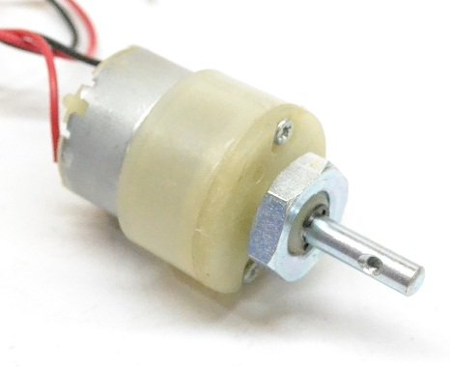
4.DC Motor
A machine that converts D.C power into mechanical power is known as a DC motor. Its operation is based on the principle that when a current carrying conductor is placed in a magnetic field, the conductor experiences a mechanical force. The direction of this force is given by Fleming’s left hand rule and magnitude is given by F = BIL (Newtons)
B=Magnetic Field
I=Current
L=Length of wire
Basically, there is no constructional difference between a D.C. motor and a D.C. generator. The same D.C. machine can be run as a generator or motor.

Slide 11
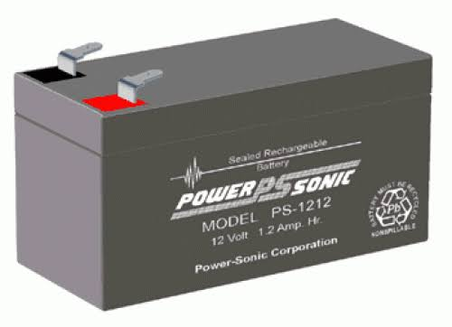
5. 12V Battery
A rechargeable battery is an energy storage device that can be charged again after being discharged by applying DC current to its terminals.
Rechargeable batteries allow for multiple usages from a cell, reducing waste and generally providing a better long-term investment in terms of dollars spent for usable device time. This is true even factoring in the higher purchase price of rechargeable and the requirement for a charger.
A rechargeable battery is generally a more sensible and sustainable replacement to one-time use batteries, which generate current through a chemical reaction in which a reactive anode is consumed. The anode in a rechargeable battery gets consumed as well but at a slower rate, allowing for many charges and discharges.

Slide 12
Software Details
Arduino IDE
The open-source Arduino Software (IDE) makes it easy to write code and upload it to the board. It runs on Windows, Mac OS X, and Linux. The environment is written in C and based on Processing and other open-source software. This software can be used with any Arduino board.

Slide 13
Embedded C
The C language programming is designed for function with variables, character set, data types, keywords, expression and so on are used for writing a C program. The extension in C language is known as embedded C programming language.

Slide 14
Working Principle
Wheelchair Model Controlled by Mems Motion moves according to hand movement as we place transmitter in our hand. When we tilt hand in front side, robot start to moving forward and continues moving forward until next command is given.
When we tilt hand in backward side, robot change its state and start moving in backwards direction until other command is given. When we tilt it in left side Robot get turn left till next command.
When we tilt hand in right side robot turned to right. And for stopping robot we keep hand in stable.

Slide 15
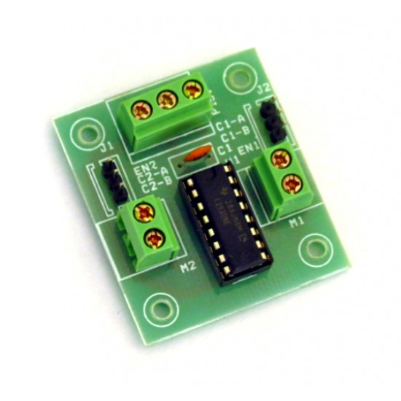
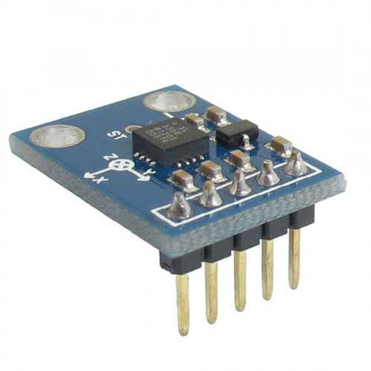
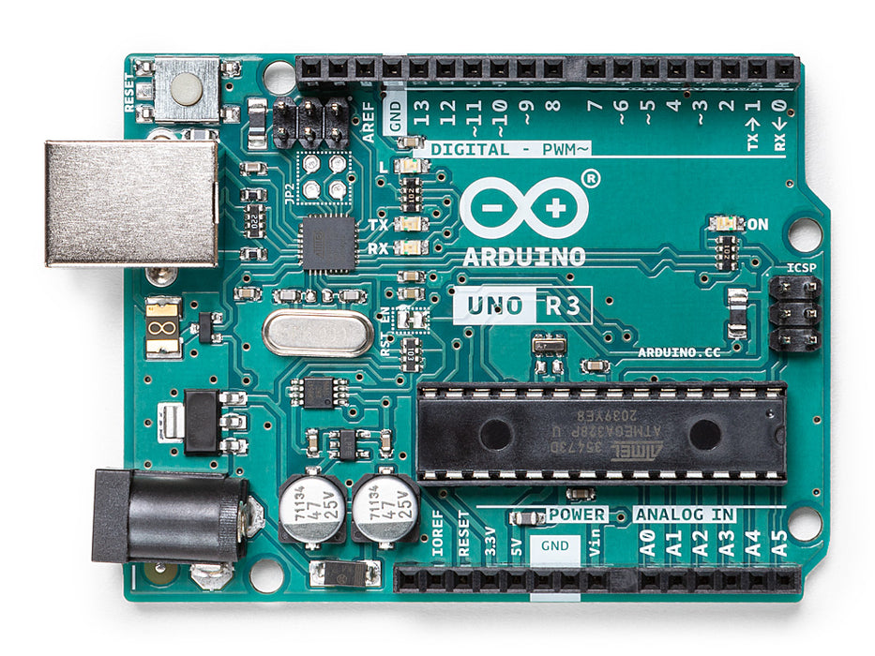

Connection Diagram

Slide 16
Algorithm
STEP 1 :- Switch on the motor.
STEP 2 :- If the MEMS sensor is in threshold value the motor is in off state.
STEP 3 :- In x-axis if the threshold value is less than 380 then motor will move in right direction.
STEP4 :- In x-axis if the threshold value is greater than 400 then motor will move in left direction.
STEP5 :- In y-axis if the threshold value is less than 380 then motor will move in front direction.
STEP6 :- In y-axis if the threshold value is greater than 400 then motor will move in back direction.

Slide 17
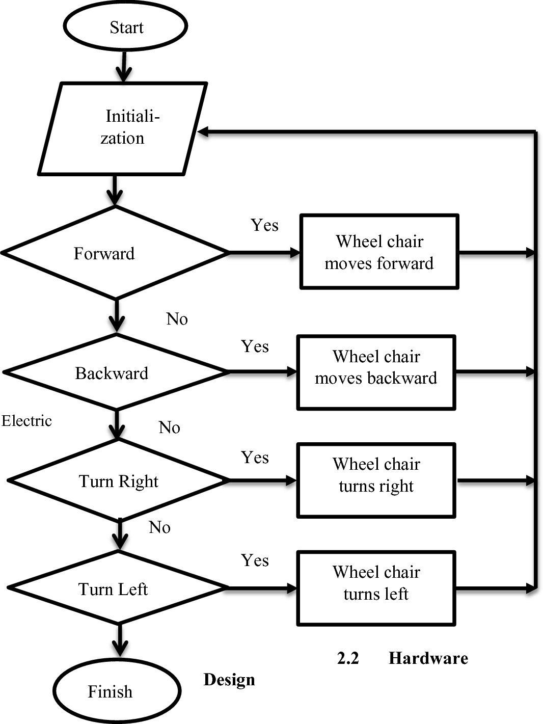
Flow chart

Slide 18
Applications
Wireless controlled robots are very useful in many applications like remote surveillance, military etc.
Hand gesture-controlled robot can be used by physically challenged in wheelchairs.
Hand gesture controlled industrial grade robotic arms can be developed.

Slide 19
Results
In this robot is designed in which it moves according to human hand gesture. The robot is moving in order of proper responses whenever we move our hand. Different Hand gestures to make the robot in specific directions are left, right, forward, backward.

Slide 20
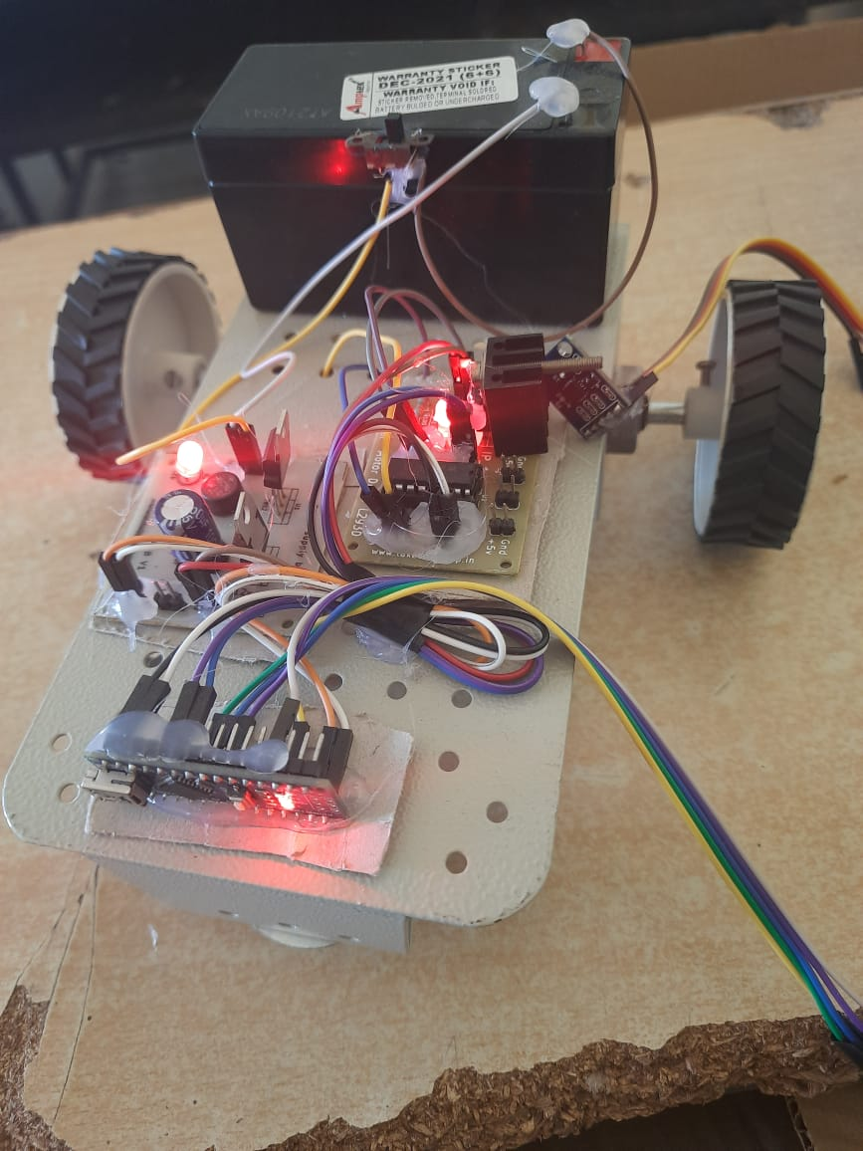
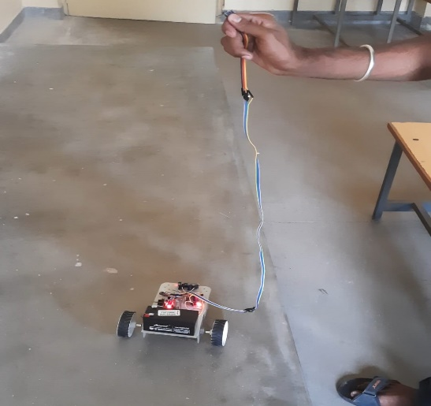
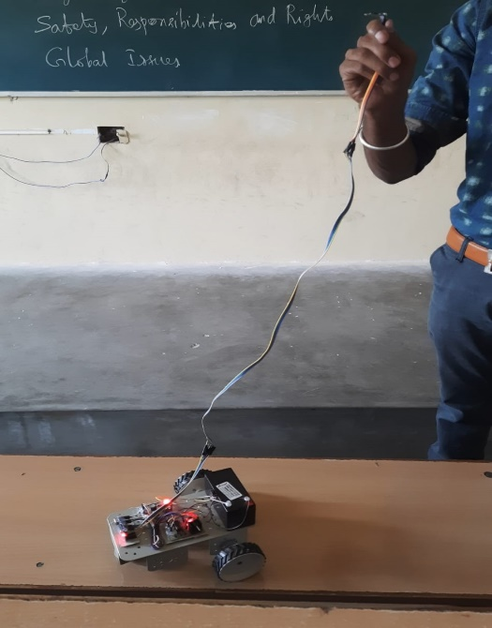
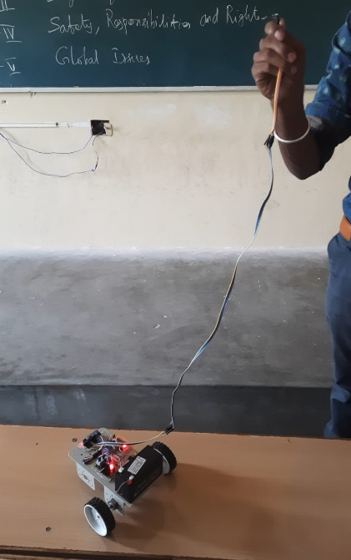

Slide 21
References
(14-16 July 2008), A Wearable Head- Mounted Sensor Based Apparatus for Eye Tracking Applications IEEE International Conference on Virtual Environments, Human-Computer Interfaces, and Measurement Systems Istanbul, Turkey.
(2007) 4 International conference on Electrical and Electronics Engineering (ICEEE 2007) Mexico City, Mexico. September 5-7, Marhic.B.
(2005) Robotic assistance: an automatic wheelchair tracking Intelligent Robots and Systems, (IROS2005). 2005 IEEE/RSJ. Yi Zhang, Jiao Zhang, Yuan Luo (2011), A Novel Intelligent Wheelchair Control System Based On Hand Gesture Recognition, Proceedings of the 2011 IEEE/ICME International Conference on Complex Medical Engineering, May 22-25,Harbin,China,pp:334- 339,201. Wen J .Li (May, 2012), MEMS Accelerometer Based Nonspecific-User Hand Gesture Recognition. IEEE SensorsJournalVol12, No.5.pp:1166-1173. Wheel Chair Motion Control Based On Hand Gesture Recognition IJIRTS volume2 No2

Slide 22
Thank you

